Slide 1
Al-Farabi Kazakh National University
Department of Philosophy and Political Science
Political Science Introductory Course
Spring Semester, 2020 - 2021 Academic Year
Lecture 10: Political Ideologies
by Marem Buzurtanova, Senior Lecturer
e-mail: marem_buzurtanova@hotmail.com
Phone number: 87773707063

Slide 2
LECTURE 10: POLITICAL IDEOLOGIES CONSERVATISM, LIBERALISM, SOCIALISM, NATIONALISM
The lecture covers the following:
1. Ideological Dimension of Politics:
1.1. Political Values;
1.2. Political Behavior/Choice/Action;
1.3. Political Ideology.
2. Political Spectrum:
2.1. Conservatism, Liberalism, and Socialism:
2.2. Nationalism.

Slide 3
LECTURE 10: POLITICAL IDEOLOGIES CONSERVATISM, LIBERALISM, SOCIALISM, NATIONALISM
Political Values
Value
the regard that something is held to deserve; the importance, worth, or usefulness of something;
principles or standards of behavior; one's judgement of what is important in life.
Political Values: recognition by political actors (individuals, groups, classes, nations, etc.) of the necessity/significance/desirability of certain phenomena, processes and norms of political life. They motivate, direct and justify the actions of political actors. The main political values ​​include the principles of the political structure and development of society. Political values ​​can be universal, national, or reflect the primary interests of classes, groups of people, individuals.

Slide 4
LECTURE 10: POLITICAL IDEOLOGIES CONSERVATISM, LIBERALISM, SOCIALISM, NATIONALISM
Political Behavior - Political Choice
Political Behavior and Political Choice are similar but not the same.
Political Behavior and Political Choice are interrelated and interdependent categories and phenomena.
Political Behavior (subset of human behavior) is a set of actions of individuals, groups and societies in the field of politics that may include various forms: complete rejection, absenteeism, sporadic, reluctant or active participation using a wide range of methods.
Political Choice and Political Values may sometimes conflict each other.

Slide 5
LECTURE 10: POLITICAL IDEOLOGIES CONSERVATISM, LIBERALISM, SOCIALISM, NATIONALISM
Political Ideology
Political ideologies are the product of enlightenment/modernity
    An ideology is a set of ideas by which men posit, explain and justify the ends and means of organized social action, irrespective of whether such action aims to preserve, amend, uproot or rebuild a given social order (Seliger, 1976, p. 14).
there is a social order;
this order shall be preserved, amended, uprooted or rebuilt;
because such and such is good/desirable/possible/noble;
- It should be done by such and such means.

Slide 6
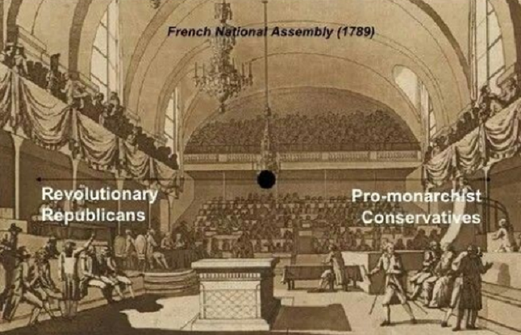
LECTURE 10: POLITICAL IDEOLOGIES CONSERVATISM, LIBERALISM, SOCIALISM, NATIONALISM
Political Spectrum
The left–right political spectrum - to classify political positions, ideologies and parties from social equality on the left to social hierarchy on the right.

Slide 7
LECTURE 10: POLITICAL IDEOLOGIES CONSERVATISM, LIBERALISM, SOCIALISM, NATIONALISM
Political Spectrum: from the mid 19th century until now
Conservatism
Liberalism Socialism

Slide 8
LECTURE 10: POLITICAL IDEOLOGIES CONSERVATISM, LIBERALISM, SOCIALISM, NATIONALISM
Political Spectrum: from the mid 19th century until now
Fascism (extreme)
Conservatism
Liberalism Socialism
Libertarianism (extreme) Communism (extreme)

Slide 9
LECTURE 10: POLITICAL IDEOLOGIES CONSERVATISM, LIBERALISM, SOCIALISM, NATIONALISM
Political Spectrum: from the mid 19th century until now
Conservatism
Liberalism Socialism
Chronologically
Liberalism Conservatism Socialism
End the 18th Century End the 18th Century Mid the 19th century
liberals are concerned with law, socialists are concerned with economy, society and power, and conservatives are concerned with tradition and the religion manifest in tradition.
Liberalism is a criticism of that older order. Socialism is a criticism of any liberal order as well as of the older order criticized by liberalism. And conservatism is a criticism of any socialist order as well as of any liberal order. So there is a circle (Theodor Adorno and Max Horkheimer, 1997).

Slide 10
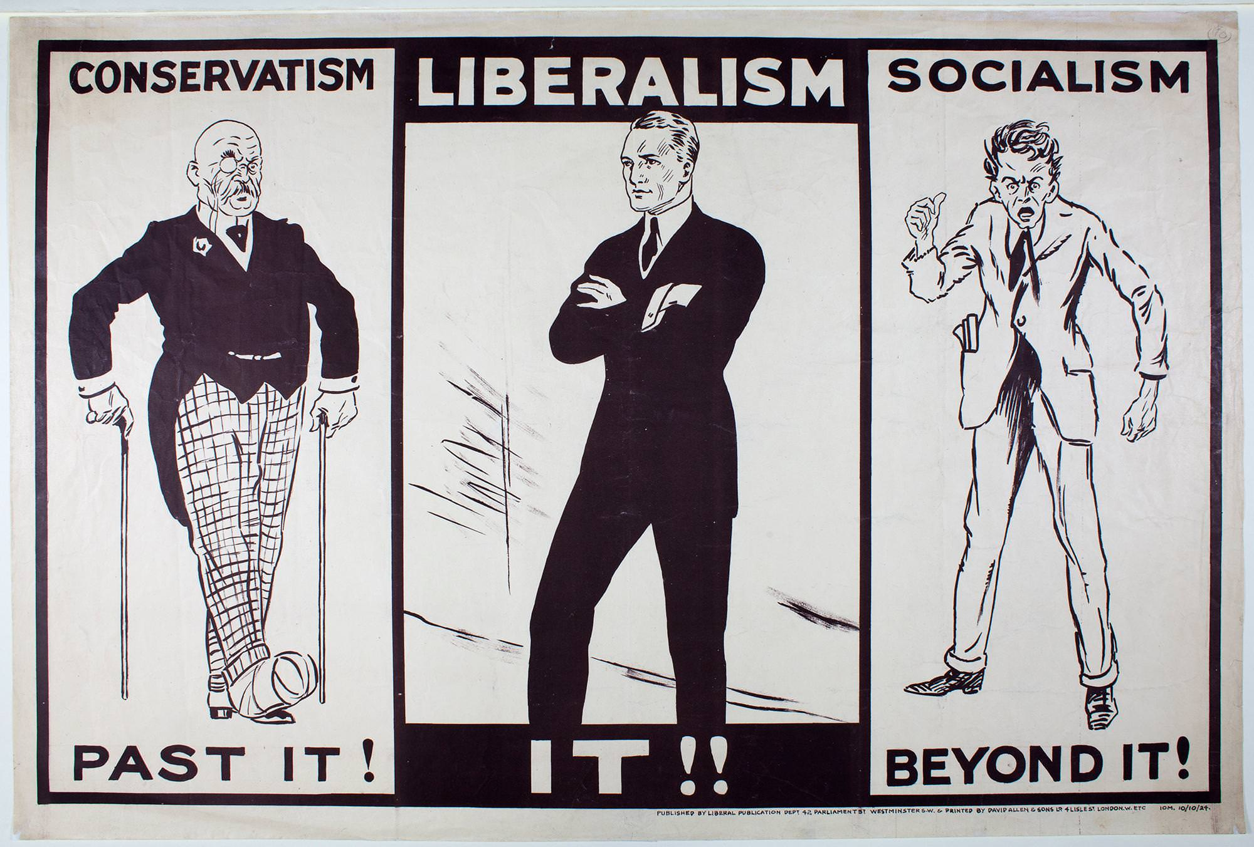
Political science introduction lecture 3

Slide 11
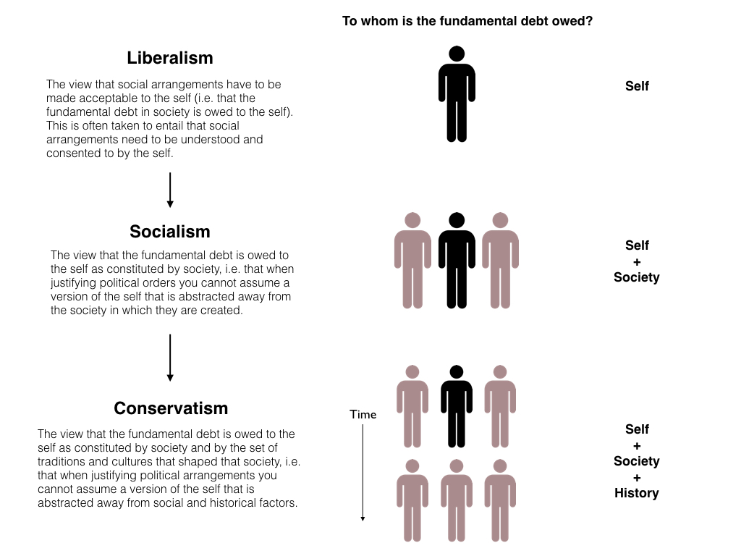
Political science introduction lecture 3

Slide 12
LECTURE 10: POLITICAL IDEOLOGIES CONSERVATISM, LIBERALISM, SOCIALISM, NATIONALISM
Liberalism
Liberalism offers the simplest critique of religion, tradition and authority (Hannah Arendt, 1990, p. 117).
limited government,
maintenance of the rule of law,
avoidance of arbitrary or discretionary power,
sanctity of private property and freely made contracts,
responsibility of individuals for their own fates.
liberal always divides the world into what is intrinsically necessary (the self ), what is necessary to support that intrinsic necessity (a system of standards, rules, laws), and what is contingent (everything else, including all other beliefs, practices and institutions). From Boloix’s Know Thyself Ideologically (2020).

Slide 13
LECTURE 10: POLITICAL IDEOLOGIES CONSERVATISM, LIBERALISM, SOCIALISM, NATIONALISM
Conservatism
“A partnership not only between those who are living, but between those who are living, those are dead, and those who are to be born’ (Edmund Burke, 1999, p. 193).
“Inequalities of wealth and position are inevitable and that it is therefore meaningless to discuss the advantages of their elimination (Waugh, 1939, pp. 16–7).

Slide 14
LECTURE 10: POLITICAL IDEOLOGIES CONSERVATISM, LIBERALISM, SOCIALISM, NATIONALISM
Conservatives and Change ?
Conservatives prefer the familiar to the unknown, the actual to the possible, the limited to the unbounded, the near to the distant, the convenient to the perfect.
Conservatives argue that there is no obligation to change the world because human imperfection.
‘The highest virtue in politics is to resist change until change becomes inevitable, and then to concede to it with as little fuss and as much obeisance to tradition as possible’ (Utley, 1989, p. 87).
Radical conservative?
Fundamentalists?

Slide 15
LECTURE 10: POLITICAL IDEOLOGIES CONSERVATISM, LIBERALISM, SOCIALISM, NATIONALISM
Socialism
It was not long after the French Revolution that critics of liberalism noticed that it ‘combines within itself a drive towards ideals of political equality with an actual fostering of economic inequality’ (MacIntyre, 1968, p. 133).
Socialism is a theory or belief that such an alternative is possible (Mallock, 1908).
Self is socially constructed – the main pint of socialist theory.

Slide 16
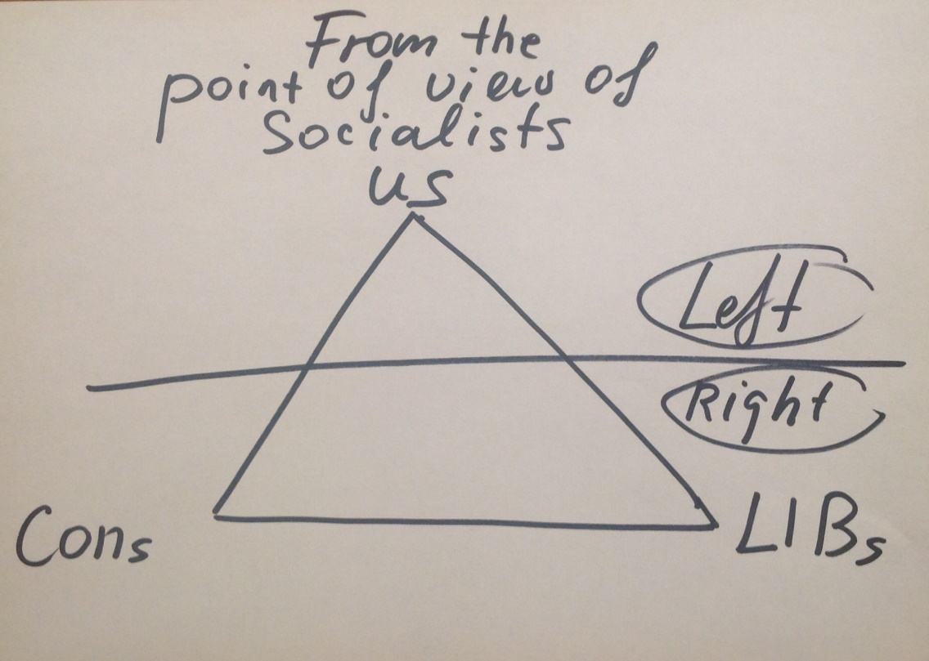
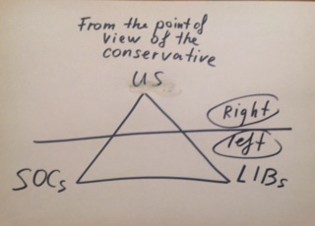
LECTURE 10: POLITICAL IDEOLOGIES CONSERVATISM, LIBERALISM, SOCIALISM, NATIONALISM
Are the liberals right or left?

Slide 17
LECTURE 10: POLITICAL IDEOLOGIES CONSERVATISM, LIBERALISM, SOCIALISM, NATIONALISM
Conservatism, Liberalism, and Socialism
Society consists of individuals – Liberalism;
Society does not consist of individuals; it expresses the sum of connections and relationships in which individuals find themselves – Socialism;
Society does not consist of individuals; it does not even express the sum of connections and relationships in which individuals find themselves: it is the expression of the connections and relationships which emerged from a past and have to be conveyed to a future – Conservatism.

Slide 18
LECTURE 10: POLITICAL IDEOLOGIES CONSERVATISM, LIBERALISM, SOCIALISM, NATIONALISM
Nationalism
Nationalism is an ideology that promotes the interests of a particular nation with the aim of gaining and maintaining the nation's sovereignty (self-governance) over its homeland.
- each nation should govern itself, be free from outside interference (self-determination);
- nation is a natural and ideal basis for a polity and the only rightful source of political power (popular sovereignty);
- single national identity based on shared characteristics such as culture, ethnicity, geographic location, language, government, religion, traditions and belief in a shared singular history, national unity or solidarity.

Slide 19
LECTURE 10: POLITICAL IDEOLOGIES CONSERVATISM, LIBERALISM, SOCIALISM, NATIONALISM
Nationalism
Civic nationalism and liberal nationalism;
Ethnic nationalism;
Economic nationalism;
Religious nationalism;
Anti-colonial nationalism;
Racial nationalism.
all liberals, conservatives and socialists may be nationalists;
nationalism is related (but not equal) to 1) patriotism, 2) chauvinism.

Slide 20
Reading
Alexander, J. (2015). The major ideologies of liberalism, socialism and conservatism. Political Studies, 63(5), 980-994.
Özkirimli, U. (Ed.). (2003). Nationalism and its Futures.
Reading is available in PDF format, see UNIVER system

